Slide 1
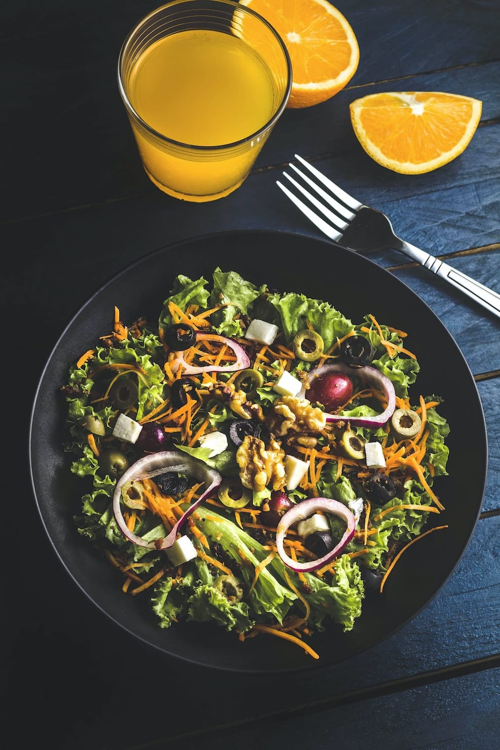

FoodZey
FoodZey
Powered by ONDC
Healthy ho Khana to FoodZey se Mangana
FoodZey: Transforming Food Experience Powered By ONDC
ORDER NOW

Slide 2
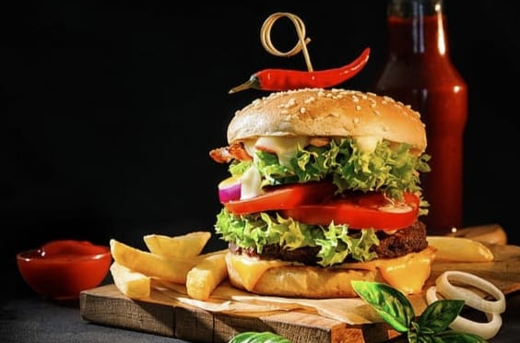
Introduction
we introduce 'FoodZey,' an innovative food delivery app designed for the Indian market. In a landscape dominated by Swiggy and Zomato, we've conducted thorough research and devised strategies to address key challenges faced by consumers, restaurants, and delivery partners. Our goal is to revolutionize food delivery in India using the ONDC protocol. Stay tuned to discover how FoodZey plans to disrupt the industry."

Slide 3
Open Network for Digital Commerce (ONDC):
A government-led initiative to transform India's digital commerce landscape.
Objectives :
⦿ Democratize digital commerce.
⦿ Promote competition.
⦿ Empower small businesses.
Key Features :
⦿ Interconnected e-marketplaces.
⦿Open and interoperable.
⦿ Merchant choice.
⦿ Consumer benefits.
Implementation :
⦿ Phased implementation for technical infrastructure and standards.

Slide 4
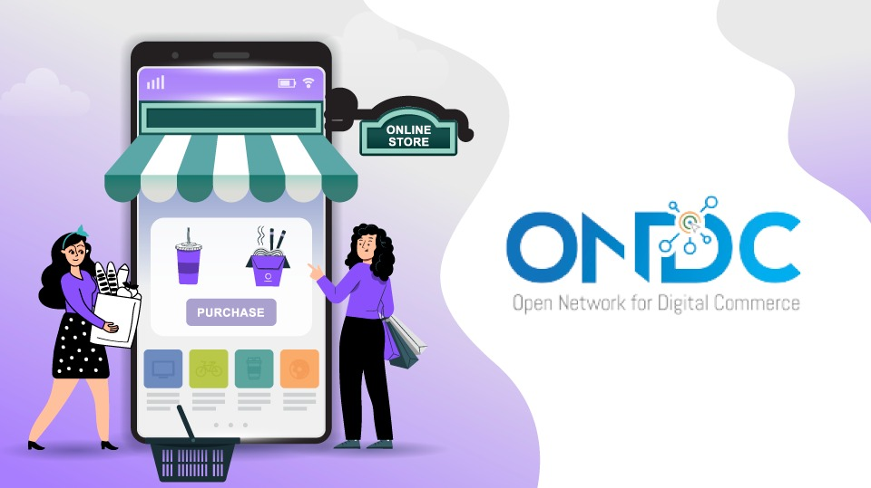
Government Support:
Backed by various government ministries.
Evokes both support and concerns within the e-commerce industry
ONDC and FoodZay :
ONDC is reshaping digital commerce in India, emphasizing ,democratization, competition, and empowerment. Its impact on the industry will continue to evolve, with FoodZay showcasing its potential
ONDC powers FoodZay, offering a unique and competitive food delivery experience.

Slide 5

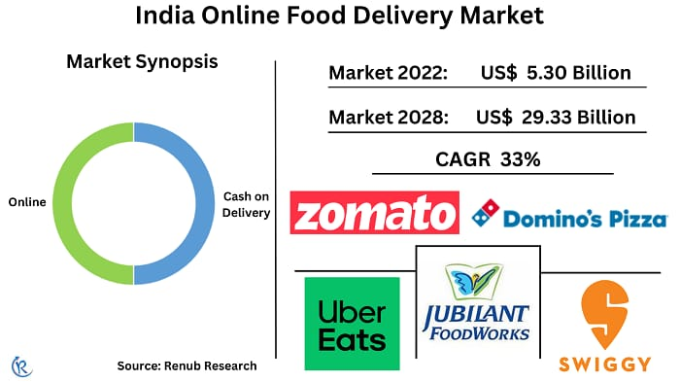
Market Analysis
Online Food Delivery consists two segments — Groceries and Meals. Meal delivery is delivering ready-to-eat (prepared) meals ordered online for direct consumption. Grocery delivery focuses on non-prepared food and beverage products, household, and personal care products. Orders are generally placed through a mobile or web application and delivered to the customers.
⦿ Market size: USD 7.5 Billion in 2022
⦿ CAGR: 19.88% (2023-2027)
⦿ User penetration in 2023: 35.0%
Dominated by Swiggy and Zomato (67% market share)
Major regions: Bangalore, Delhi-NCR, Mumbai, Hyderabad, Pune
Major delivery types: Restaurant-to-consumer and platform-to-consumer

Slide 6

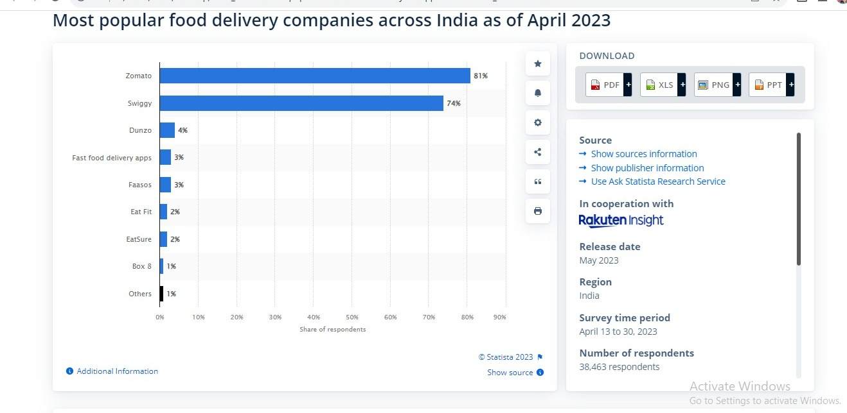
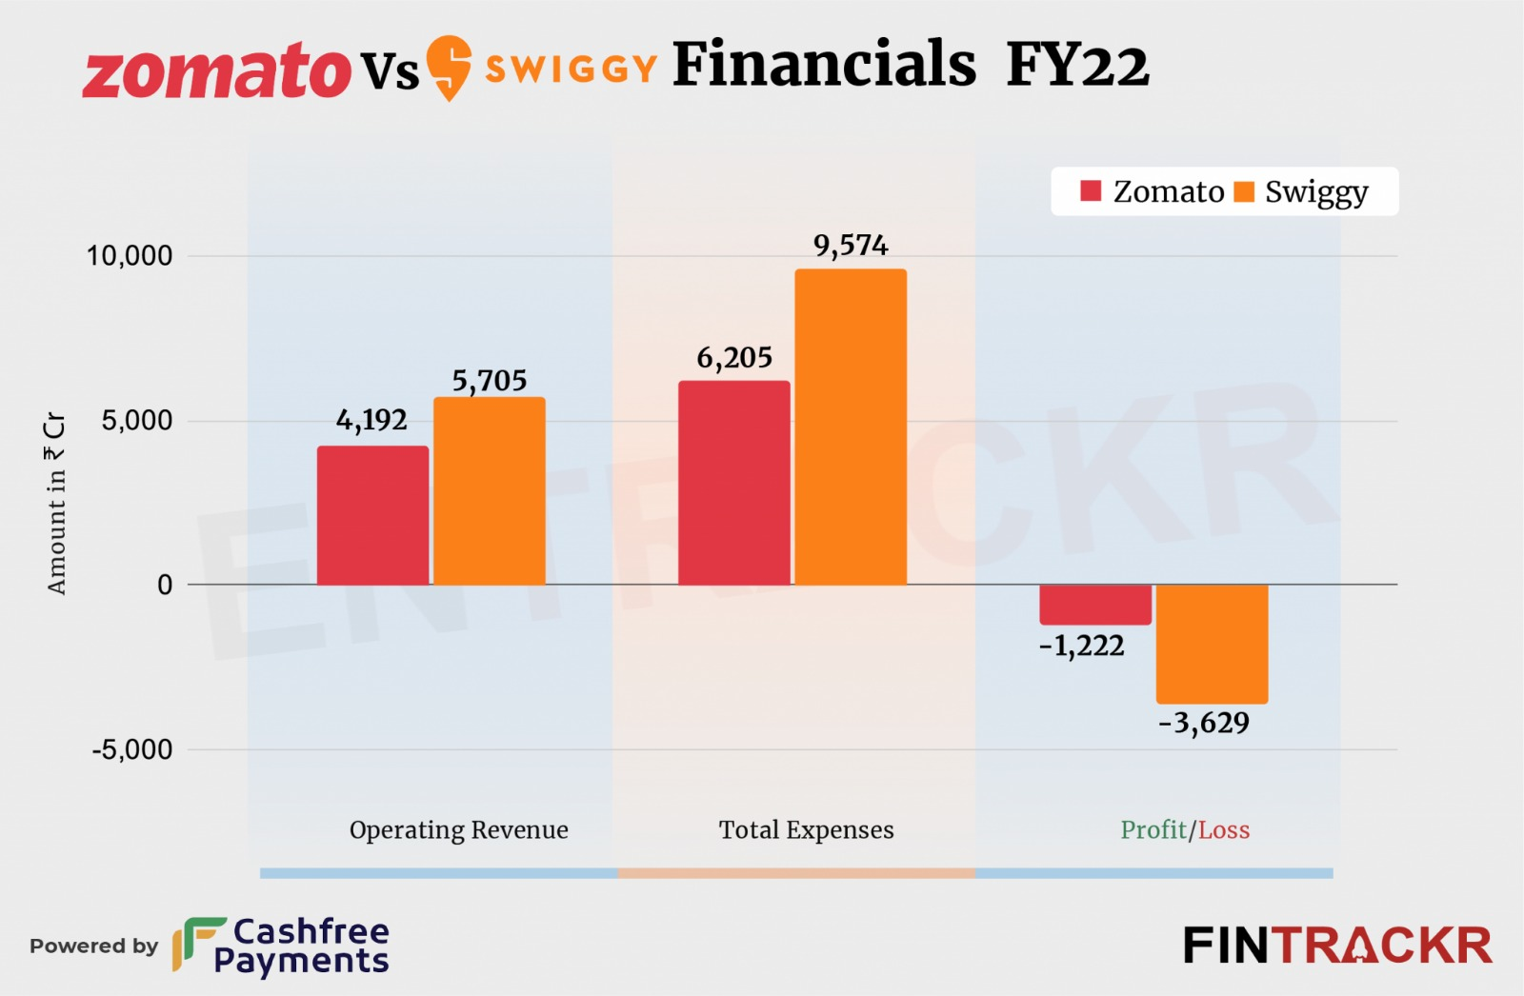
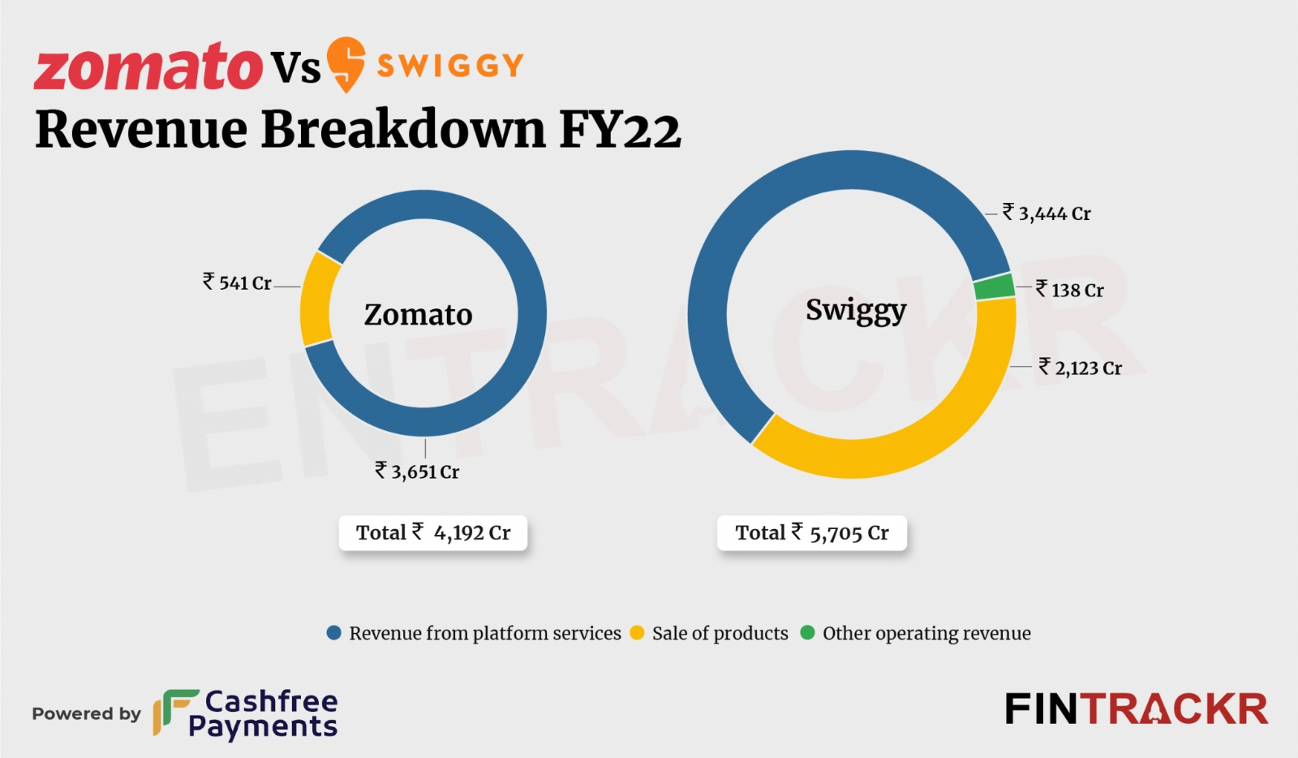
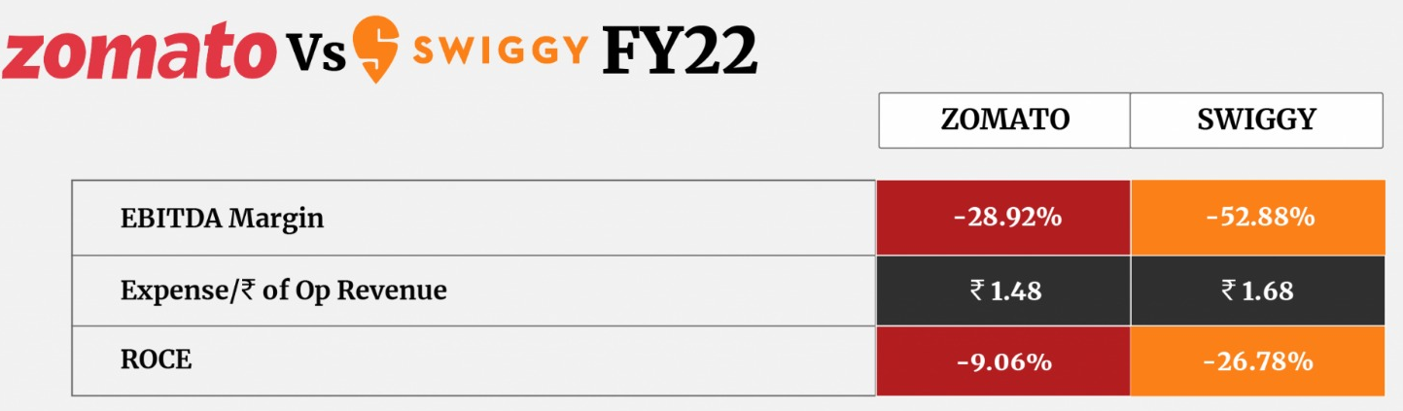
The food delivery market has been a hotly contested
space between Zomato and Swiggy.
Below we have discussed their detailed analysis

Slide 7

Research Findings
✸ Customers:
• High delivery fees:
.
• Long delivery times:
• Poor customer service:
• Food quality issues:
• Long waiting time for Problem Resolving
✸ Restaurants:
• High commissions:
• Dependency on Swiggy and Zomato:
• Loss of control over customer experience:

Slide 8
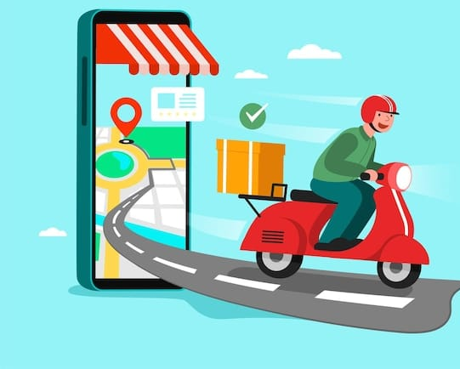
Delivery partners
✸ Long working hours:.
✸ Unreliable earnings:
✸ Dangerous working conditions
✸ No benefits:

Slide 9
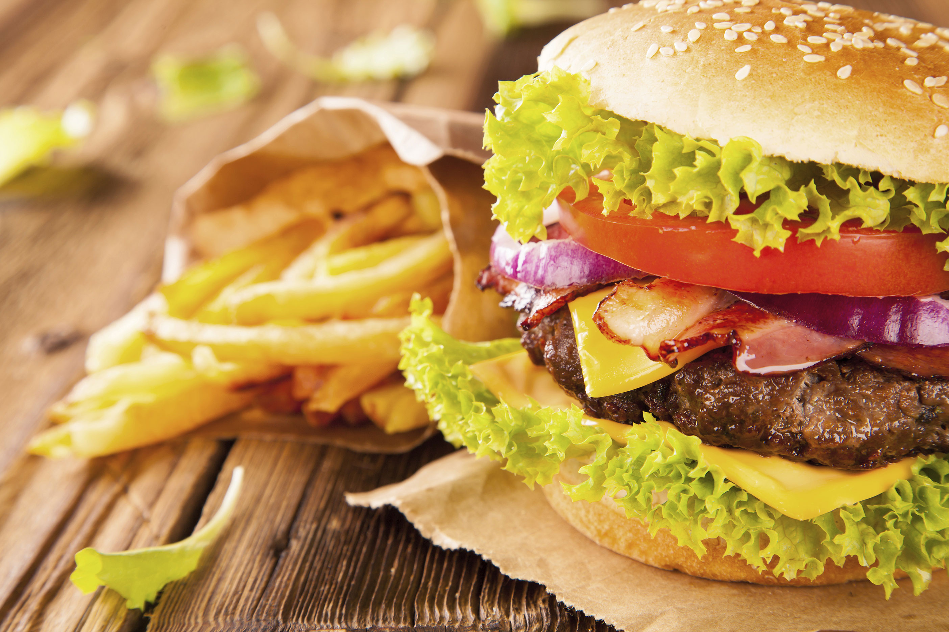
ABOUT OUR APPLICATION
➢ Introducing FoodZey , the new ONDC-powered app for food delivery. With FoodZey , you can order food from your favorite restaurants and have it delivered to your door in minutes.

Slide 10
Solution
Addressing Unemployment and Long Working Hours:
Enhance Advanced Drone Technology:
Introducing Advanced Features(Food Gpt)
Real-time Order Tracking
affordable delivery charges
.
Quality Assurance by Collaborate with top-quality restaurants
.

Slide 11
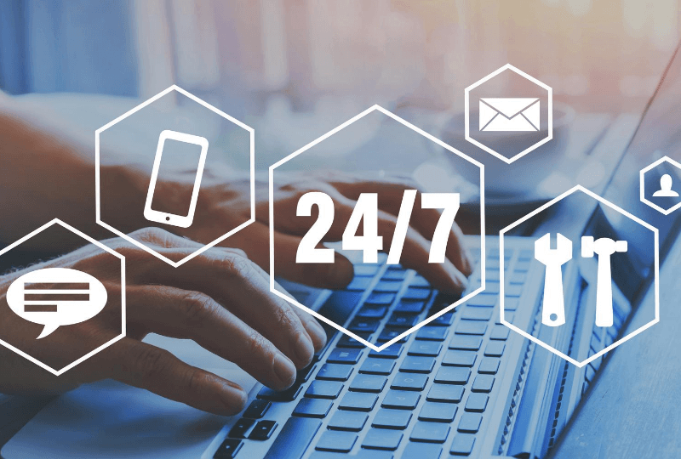
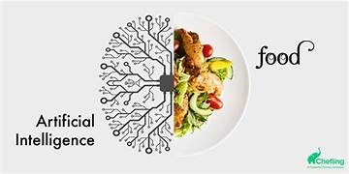


Application Features
➪ 24/7 Customer Support
With AI Chat Bot
➪ Food GPT Powered
Food Recommendations
➪ Weekly Mystery
Meal Challenge
➪ Photography Battle

Slide 12


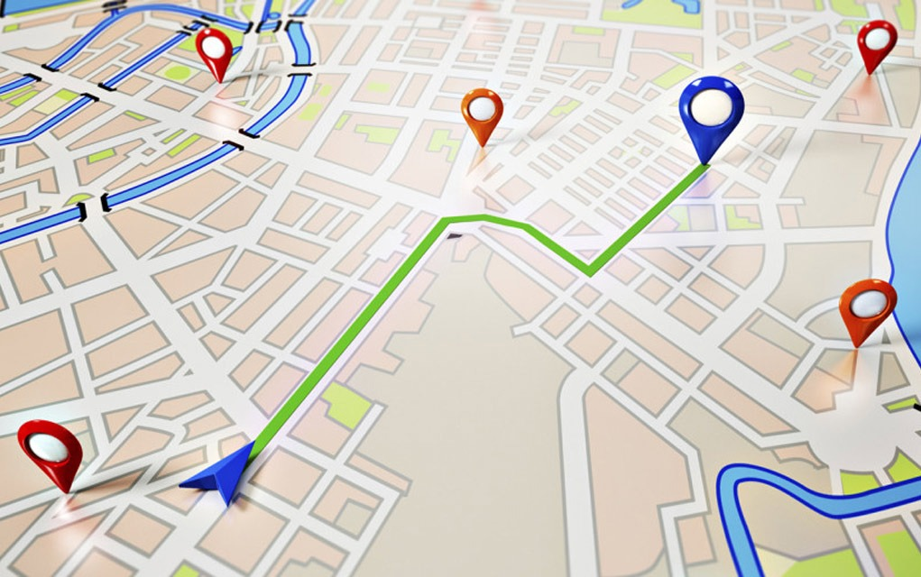
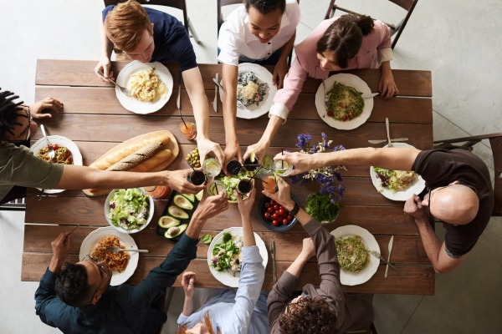
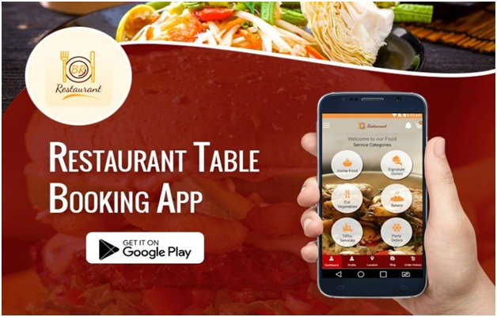
➪ User Friendly Interface
➪ Secure and Smooth payment
➪ Real Time Tracking
➪ Group orders
➪ Integration with third-party apps

Slide 13

Market Entry Strategies
TARGET AUDIENCE
⦿ health-conscious & fitness freak
⦿ Working Professional With Hectic lives
⦿ 18 to 60 age group people
❃
Pricing strategy
⦿ Psychological pricing –
Marketing Strategy
⦿Social Media Marketing
⦿ Email Marketing
⦿ Collaborations with Food Vloggers like Sinful Foodie
Aha Moment
You've just placed your order on FoodZey, and as you eagerly await your meal, you decide to explore the app a bit more. That's when it happens – your 'Aha!' moment. You discover a personalized recommendation for a dish you've never tried before, perfectly aligned with your taste preferences. It's as if FoodZey truly understands your cravings, making you wonder how you ever ordered food without it."

Slide 14

FoodZey: A redefinition in Indian food delivery.
Leveraging ONDC for innovation.
Addressing customer, restaurant, and delivery partner challenges.
Providing more choices and better deals.
Low fees, expanding delivery network, and renowned partnerships.
A game-changer in the Indian food industry.
Join us on this exciting journey with FoodZey

